Slide 1
How HOT is FHIR?
Come find out!
Fast, Modern, Implementer-friendly
130+ FHIR-related quarters this week
See the complete list on the wiki:
http://tinyurl.com/fhir201609
Help us get ready for STU 3 publication
Check out the specification
http://hl7.org/fhir

Slide 2
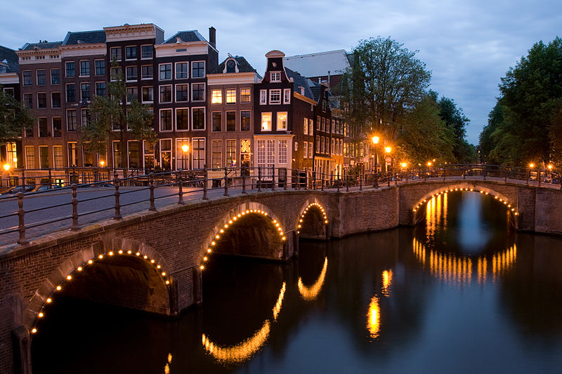





International HL7 FHIR Developer Days November 16-18, 2016 in Amsterdam
Education
12 speakers
16 tutorials/presentations
18 tracks
Connectathon
Meet fellow developers
Put FHIR to the test
Networking
FHIR experts and authors on hand
http://fhir.furore.com/devdays

